Slide 1
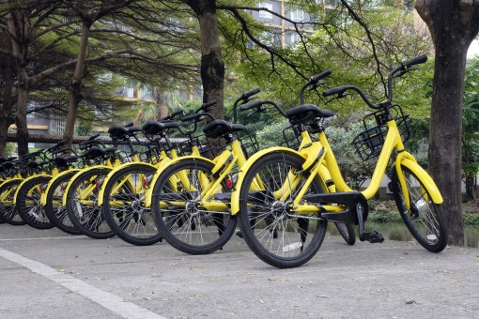
Bike Sharing Demand Prediction in Winter 2011
Internship Project at Nexthikes Batch: L-110226-W2PM-B15
Presented By: Nitesh R Dahiwale

Slide 2
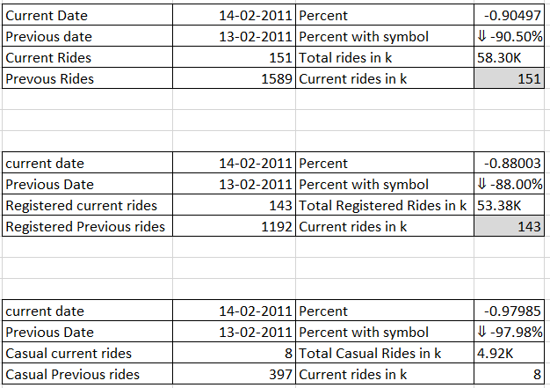
Bike Rental Ride Demand Insights
Total bike Ride dropped significantly (~90%) from 13 Feb to 14 Feb, indicating a sharp decline in demand.
Registered users showed a major decrease (~88%), meaning even regular users were less active.
Casual users experienced the highest drop (~98%), suggesting almost no occasional riders on the current day.
Overall, 14 Feb recorded extremely low demand, possibly due to external factors like weather, day type, or other conditions.

Slide 3
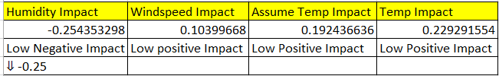
Low Correlation Factors Analysis
Humidity shows a low negative correlation (-0.25) with bike demand, indicating a slight decrease in rentals as humidity increases.
Windspeed has a weak positive correlation (0.10), suggesting minimal impact on overall demand.
Temperature-related factors (0.19–0.22) show only a low positive relationship, meaning their influence on demand is limited.
Due to these low correlation values, these factors were not included as key KPIs, as they do not significantly impact business decisions.

Slide 4
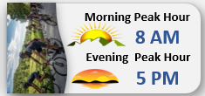
Peak Hour Demand Analysis (Using VBA)
Bike demand peaks at 8 AM, indicating high usage during morning commuting hours (office/school travel).
Evening peak occurs at 5 PM, showing increased demand during return travel time.
The presence of two distinct peak periods confirms a typical daily commute pattern in bike usage.
Using VBA automation helped accurately identify peak hours, improving efficiency and reducing manual analysis effort.

Slide 5
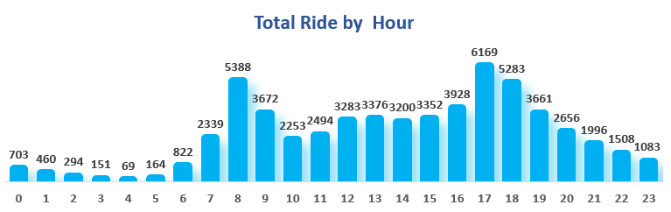
Hourly Ride Demand Analysis
Bike demand is lowest during early morning hours (midnight to 5 AM), indicating minimal usage during non-working hours.
Demand starts increasing after 6 AM and reaches a peak in the morning, showing strong commuter activity.
A second peak is observed in the evening hours, representing return travel patterns.
Midday demand remains relatively stable, indicating moderate usage throughout the day.
The pattern clearly highlights two peak periods and low night demand, which can help in resource

Slide 6
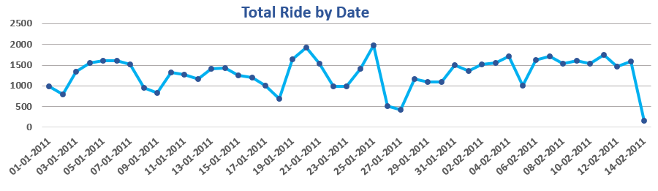
Demand Trend Analysis (By Date)
Bike demand shows noticeable fluctuations over time, indicating varying usage patterns.
Certain days experience peaks, reflecting higher activity or favorable conditions.
Sudden drops suggest the impact of external factors like weather or day type.
Overall trend remains moderately stable with periodic highs and lows.

Slide 7
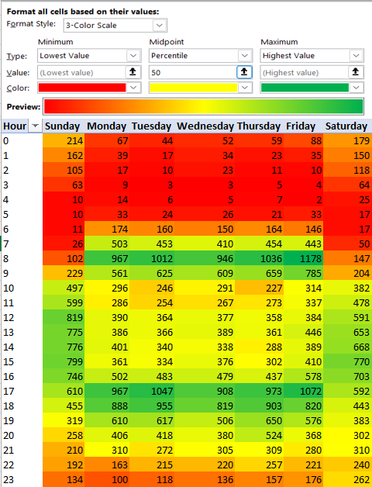
Heatmap Analysis of Hourly Bike Demand
Low demand during night and early morning hours
Peak demand observed during morning and evening
Demand remains high across most days (including weekends)
Clear variation between peak and off-peak hours

Slide 8
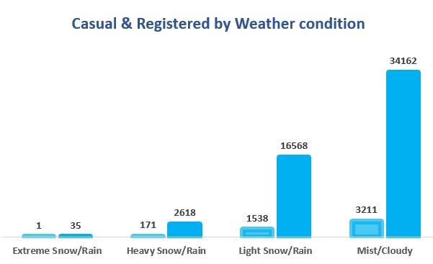
User Demand by Weather Condition
Bike demand increases as weather conditions improve.
Favorable weather conditions show the highest usage.
Extreme weather conditions result in very low demand.
Registered users contribute more than casual users across conditions.

Slide 9
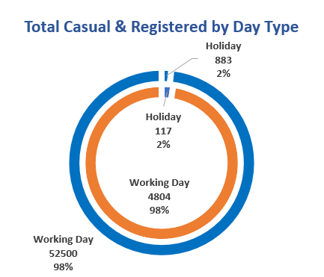
User Distribution by Day Type
Bike demand is significantly higher on working days compared to holidays.
Holidays contribute a very small portion of overall usage.
Both casual and registered users follow a similar usage pattern across day types.
Working days dominate total demand, indicating regular daily usage behavior.

Slide 10
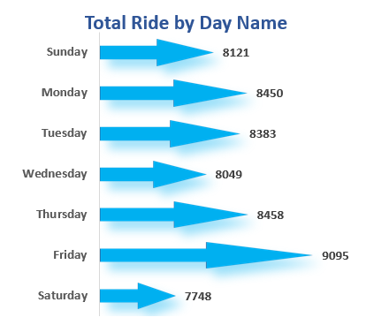
Ride Demand by Day of Week
Bike demand varies across different days of the week.
Certain days show relatively higher demand compared to others.
Demand remains fairly consistent with slight fluctuations throughout the week.
Weekly patterns help identify high and low demand days for better planning.

Slide 11
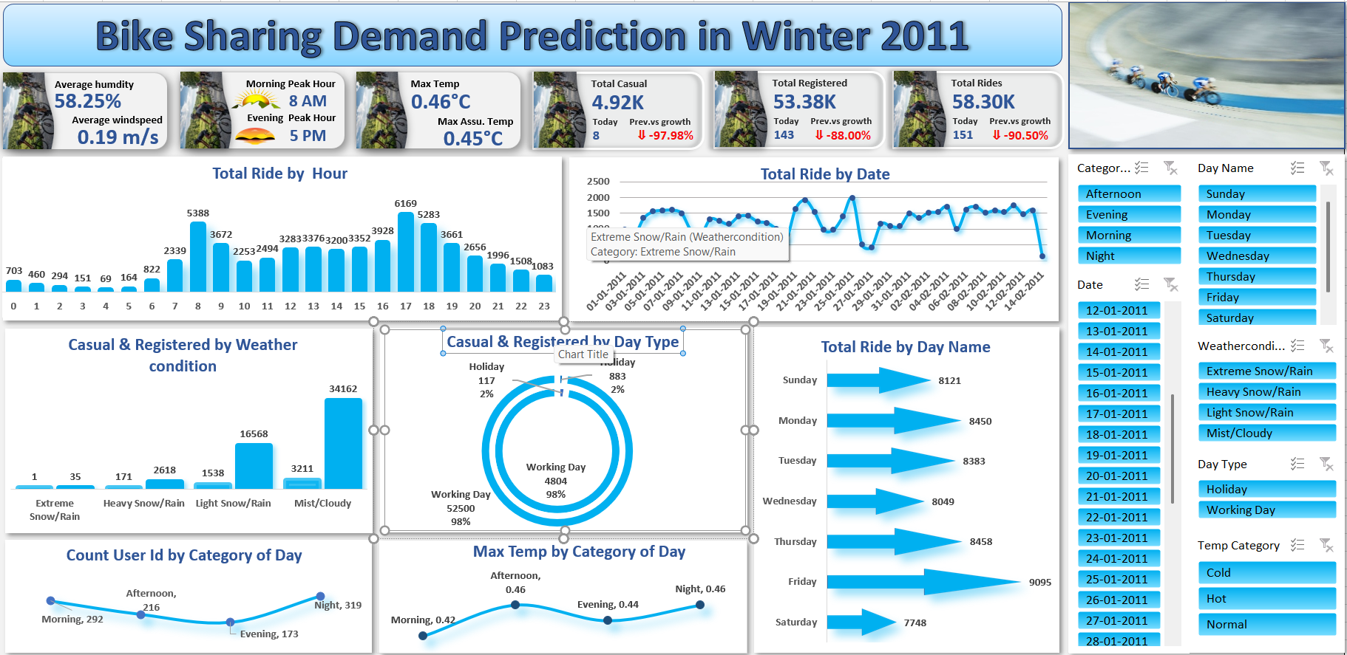
Conclusion & Key Takeaways
Bike demand varies based on time, weather conditions, and day type
Peak demand is observed during morning and evening hours
Favorable weather conditions lead to higher usage, while extreme weather reduces demand
Working days contribute significantly more demand compared to holidays
Dashboard enables clear identification of demand patterns for better decision-making

